Slide 1

Enhancing User Experience: Building a Chatbot with HTML, CSS, JS, and OpenAI API Integration

Slide 2

Enhancing User Experience
Welcome to the presentation on Enhancing User Experience through building a chatbot with
, , , and OpenAI API integration. This session will explore the key elements of creating
a seamless user experience.

Slide 3

Understanding Chatbots
Chatbots are -powered virtual assistants designed to simulate human conversation. They can provide instant support, answer queries, and personalize interactions. Leveraging chatbots can significantly improve user engagement and satisfaction.

Slide 4
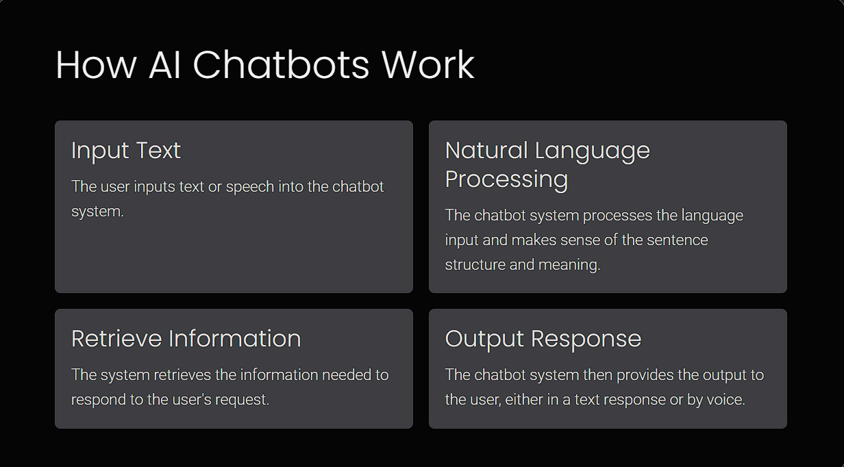

Slide 5

The Power of HTML, CSS, and JS
HTML, CSS, and JS are the building blocks of web development. With these technologies, we can create dynamic and interactive interfaces, ensuring a seamless user experience. Let's explore their role in chatbot development.

Slide 6

Integrating OpenAI API
The OpenAI API provides advanced language processing capabilities, enabling chatbots to understand and respond to user input more effectively. Integrating this API can elevate the intelligence and responsiveness of the chatbot.

Slide 7
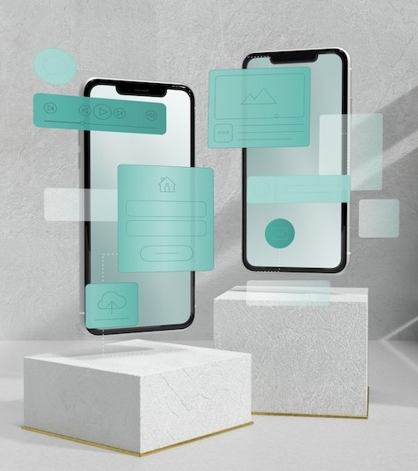
Designing the User
Interface
A well-crafted user interface is crucial for a chatbot's success. Through thoughtful design, we can ensure a visually appealing and intuitive experience for users, enhancing engagement and
satisfaction.

Slide 8

Ensuring Seamless Integration
Seamless integration across platforms and devices is essential for maximizing user accessibility. By optimizing compatibility and responsiveness, we can ensure a consistent and engaging chatbot experience.

Slide 9

Enhancing User Engagement
Engaging users through compelling conversations and interactive features is crucial.
By incorporating multimedia elements,
interactive prompts, and engaging content, we can captivate users and enhance their overall experience.

Slide 10

Leveraging Natural Language Processing
Natural Language Processing ( ) empowers chatbots to understand and respond to human language more effectively. By leveraging NLP algorithms and techniques, we can enhance the chatbot's conversational capabilities and user experience.

Slide 11

Optimizing Performance and Speed
Optimizing the performance and speed of the chatbot is essential for delivering a seamless and responsive user experience. By prioritizing efficiency and responsiveness, we can ensure swift and effective interactions.

Slide 12
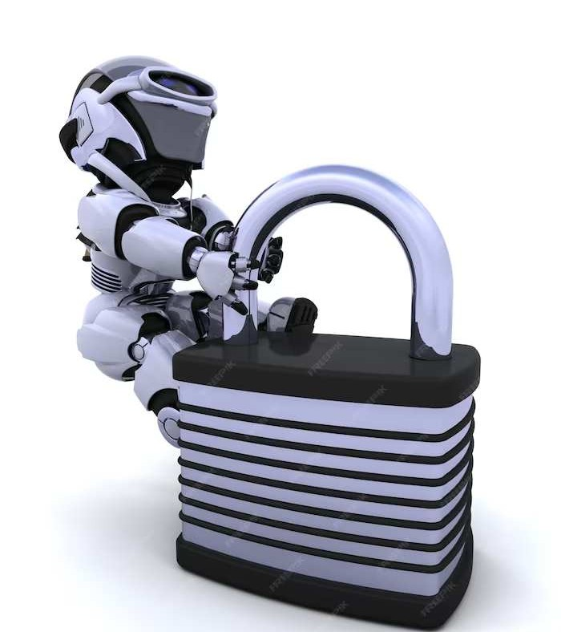
Ensuring Data Privacy and Security
Safeguarding user data and ensuring privacy and security are paramount. Implementing robust security measures and data encryption protocols is essential for building trust and confidence among users.

Slide 13
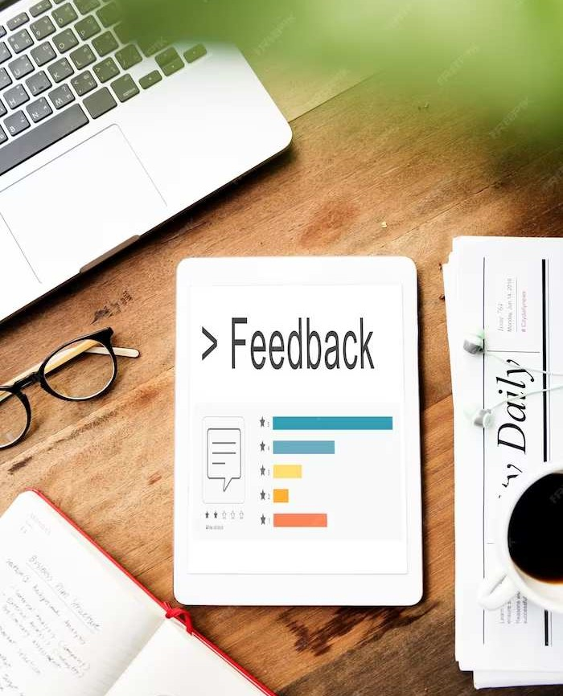
Measuring User Satisfaction
Measuring user satisfaction and feedback is crucial for refining and improving the chatbot experience. By gathering and analyzing user insights, we can continuously enhance the chatbot's performance and user satisfaction.

Slide 14
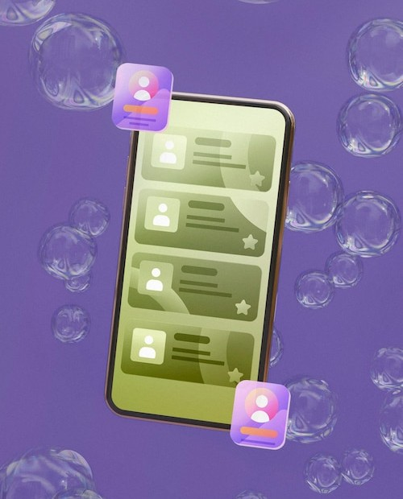
Adapting to User Feedback
Adapting to user feedback and evolving user preferences is essential for maintaining relevance and effectiveness. By incorporating user suggestions and feedback, we can ensure that the chatbot continues to meet user needs and expectations.

Slide 15

Embracing Continuous Improvement
Embracing a culture of continuous improvement is vital for chatbot success. By iterating, testing, and refining the chatbot experience, we can ensure that it evolves to meet changing user needs and technological advancements.

Slide 16

Empowering Conversational AI
Empowering conversational AI through innovative technologies and integrations can revolutionize user interactions. By staying at the forefront of AI advancements, we can deliver cutting-edge chatbot experiences that redefine user engagement.

Slide 17
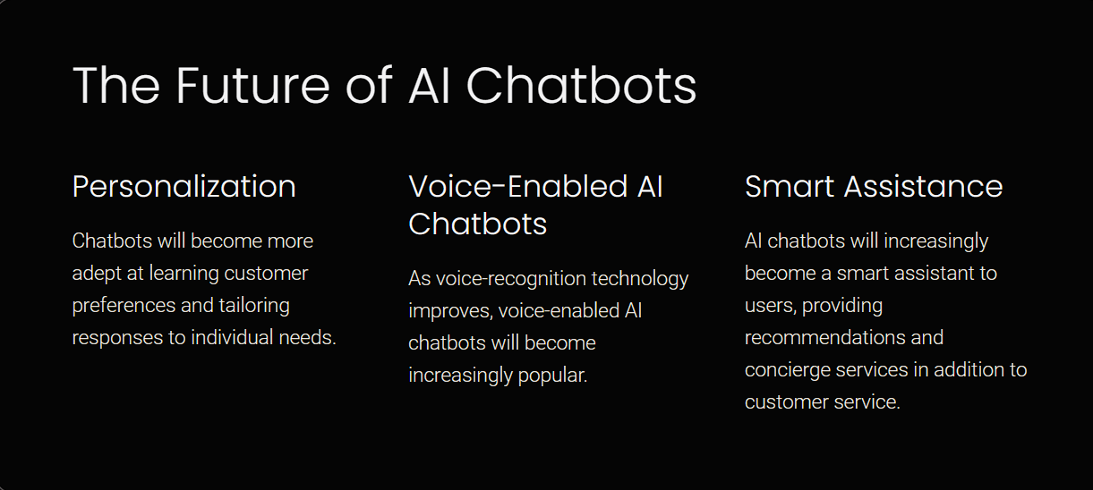

Slide 18
Key Takeaways
In conclusion, building a chatbot with
,
, , and
OpenAI API integration can significantly enhance user experience. By prioritizing design, personalization, and continuous improvement, we can create compelling and impactful chatbot interactions.

Slide 19
Thanks!

